Slide 1
Node2vec on HackForum data
~ Jash Shah

Slide 2
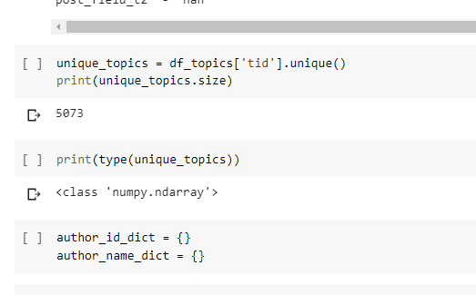
Updates on previous week’s task
Typically worked on IronMarch dataset - because the size was small.
Using Queries - total unique topics found were - 5073.
Created a dictionary for topic and corresponding nodes that discussed on it.

Slide 3
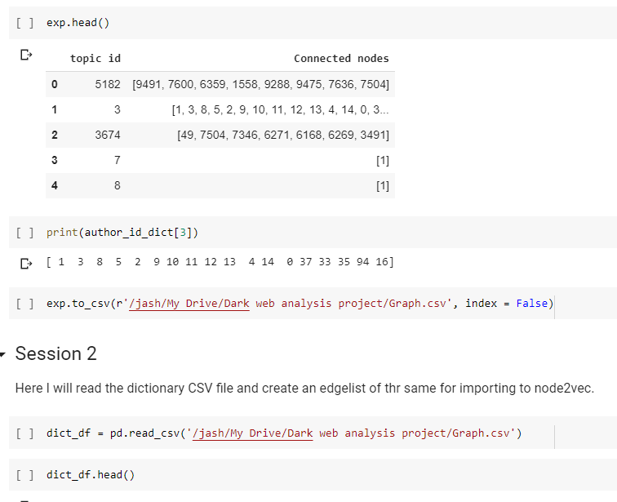
Later on, the embeddings were formed …...
Notes:
Issue - the dimensionality reduction was an issue and hence we could not display the embeddings as seperate groups.

Slide 4
Understanding Node2Vec..
How are graphs equivalent to sentences ?
#1 - Jash is a boy
#2 - Akash is a boy ( Ignore the grammar and consider that have = has)
#3 - Boys have beard
Test case - Jash has beard => Akash has beard
Word2Vec

Slide 5
N1
N2
Jash
Boy
#1 - [ N1 - N2 ]
#2 - [ N3 - N2 ]
#3 - [ N3 - N4 ]
#Test - [ N1 - N4 ] = [ N3 - N2 - N4 ]
After applying Word2vec on this “ pseudo sentences” we have the algorithm called Node2Vec.
Node2Vec
N3
Akash
N4
Beard
Typical Graph

Slide 6
2. Working of word2vec and/or node2vec...
Word2vec -> Window size applied and then, Skip-Gram model or CBOW model is used to learn embeddings
2 layer Neural model is trained and, only the weight matrix is multiplied to get the embeddings
In actual essence - Input multiplied with weight means predicted output, without the classification step ……………………….
Node2vec -> Random walk used and then Skip gram used ( usually )
Random walk is implemented using DFS and BFS type model is controlled using edge probabilities.
In case DFS used, we learn global features and in case of BFS, the connections are learnt.

Slide 7
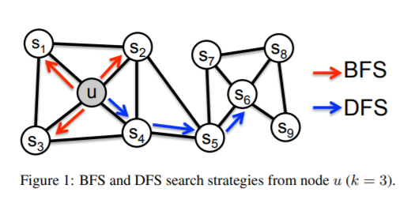
Random Walk strategy as used in the original paper

Slide 8
3. Output of model….
Importance of of such models -
Lower dimensions - 1-hot encodings and related models do work but very large vectors would have to be dealt with.
Complex relations can be analysed - Mixture of all the dimensions ( vectors) means easy vector algebra. This is the same reason why fuzzy logic is better than binary systems.
Consider only 2 dimensions in output embeddings -
Jash - [ 1 1 ] Boy - [ 5.5 5.5]
Akash - [ 10 10 ] Beard - [ 4.5 5]
Inference - Jash and Akash are 2 different entities and hence they are shown far away in the Cartesian plane. Now, as it is given that both are boys, the node boy is in exact middle of them as both of them must relate to boy in similar way ( euclidean distance as in vector algebra ). As, it is given that all boys have beard, beard is close to boy. But, the test case says Beard is close to Jash, hence, it is closer to jash.
Finally, we can see that boy and beard are close by and hance, akash also has beard.

Slide 9
A
Boy
This encapsulation is not done using Node2vec but additional models like KNN or equivalent models.
B
J

Slide 10
Mathematically speaking…
Akash - Beard + Boy = Akash { Classical Property of Word2vec }
[10 10] - [ 4 5] + [ 5.5 5.5] = [11.5 10.5]
which also verifies that anyone who has beard is a boy ( one of our training statement )

Slide 11
4. Exact details of models used ->
Considering 1-hot encoding, we will have 6 dimensions
A
B
F
We consider window size to be 1
C
D
A
And now, we will focus only one node B ……….
E
F
B

Slide 12
Classification layer
Different papers use versions of Skip-Gram models…………..
For example some have probs as their last step some have the nodes themselves
A
1 -
Hot
Of Node B
F
H.L
F
Input vector
The paper uses SGD to optimize this network

Slide 13
So, the embeddings are Input vector , dotted with ( dot product/ matrix multiplication ) hidden layer….
This also makes it semi - supervised as we are scraping off the output layer i.e. we are not using the result of the trained neural model, but only the hidden layer. Output layer ( if included ) , makes the model supervised, hence the name semi - supervised.
The embeddings, typically don’t explain the node itself, but actually is an transformation showing the relation between the input node ( in our case B ) and its other connected nodes ( Nodes A and F )

Slide 14
Weightedness and directionality
The direction will reduce the number of interactions and allow only the directed windows .
The weighted edges will alter the probability for graph transversal and hence the random walk will bring those windows that have high weighted edges between them.

Slide 15
Extra stuffs searched
Force Atlas 2 layout algorithm
Prevent Overall Behaviour Alternative
Deep Walk
GNNs
Knowledge Graphs
https://www.kaggle.com/kerneler/starter-ironmarch-30be2bbd-e
https://www.bellingcat.com/resources/how-tos/2019/11/06/massive-white-supremacist-message-board-leak-how-to-access-and-interpret-the-data/
https://fashfinder.blackblogs.org/iron-march-forum-sql-data-dump-resources/

